Slide 1
Combustion Workshops for Dublin 2018
at
Trinity College Dublin.

Slide 2
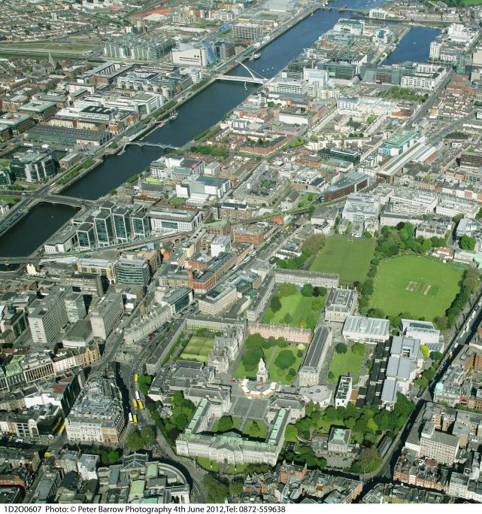
Workshops venue-Symposium Venue
Combustion Symposium Venue
“Dublin
Convention
Center”
The distance from the combustion symposium venue to TCD Arts Building is 1.7 km by road.
So, the attendees hotel should be close by to the workshops and the combustion symposium.
No hotel change would be needed.
However, room reservations have not been made for the period specific to the workshops.
Combustion Workshops Venue
“Arts Building”

Slide 3
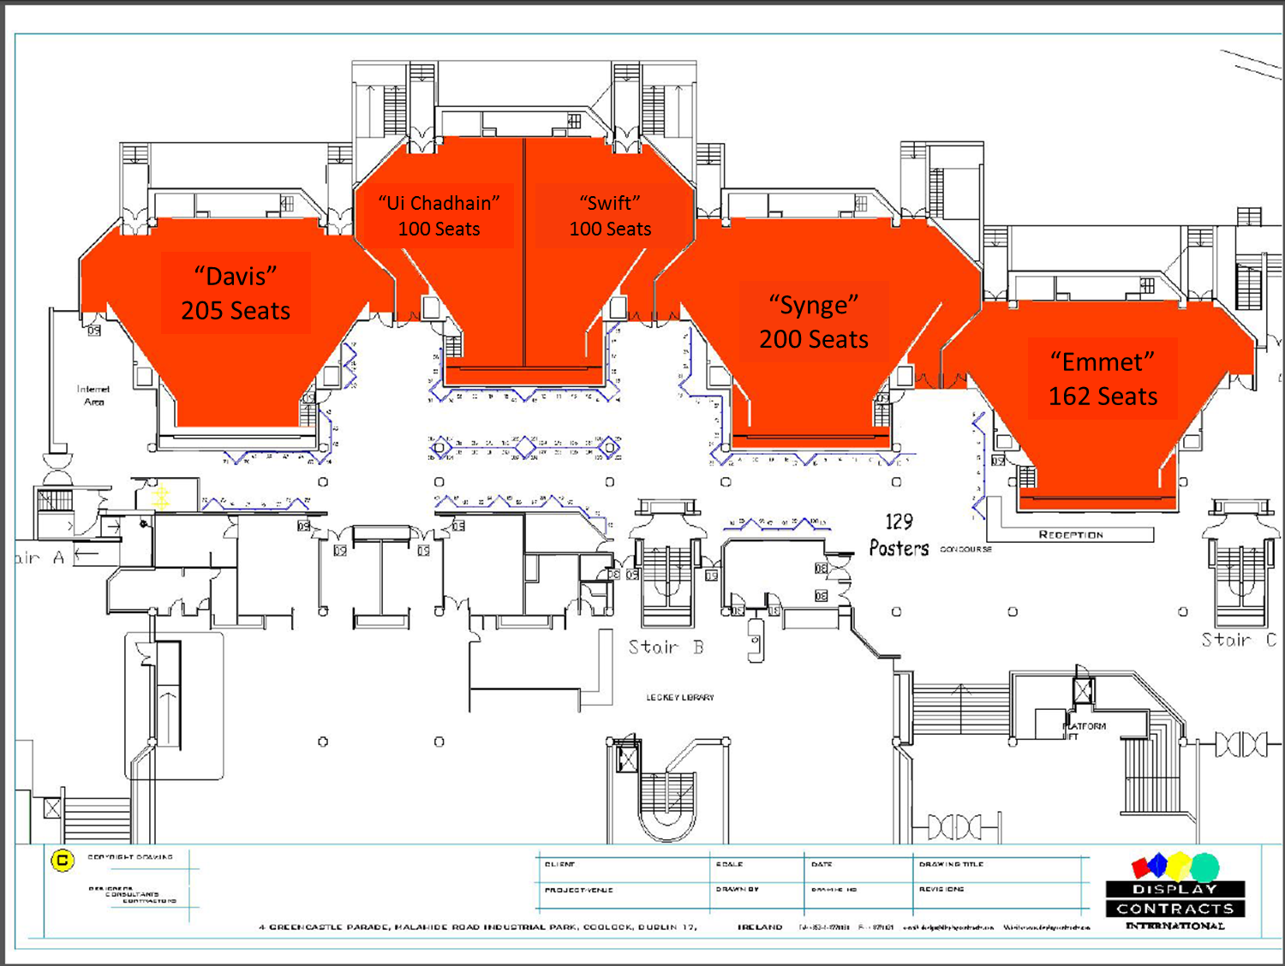
Trinity College Dublin Arts Building Floor Plan
The poster exhibition space is immediately outside the lecture theatres.
Poster
Exhibition
Space

